Slide 1
Overseas Safety & Risk Assessments Japan 28th April 2023
Gail Miller
Humanities Division Safety Officer
T: +44 (0)1865 270807 E: gail.miller@safety.ox.ac.uk
Notes:
Need to give you some idea of why all this is important and where it sits in the University’s safety management framework.
It should recap everything you’ve heard today.

Slide 2
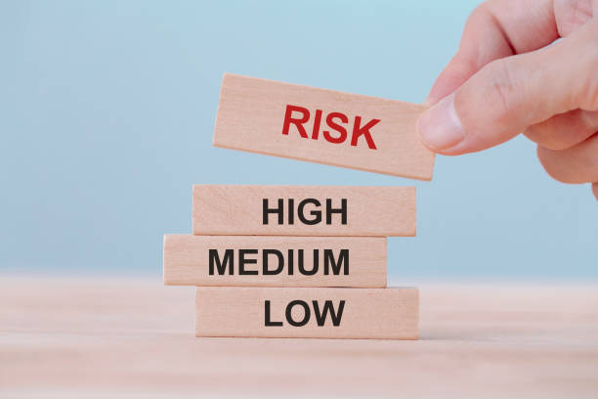
University Safety Office
Who we are and what we do?
What is a good travel Risk Assessment?
Notes:
I will talk through the basics of what the university safety office do, the travel policies that are relevant to you and provide information on the key elements of planning and risk assessment.

Slide 3
Safety Office - what we do
Health & Safety Advice
Policy Development
H&S Training
Incident Investigation
Liaise with enforcing agencies (e.g. Health & Safety Executive, Home Office, Police)

Slide 4
Key People
Brian Jenkins, Head of Safety (2)70814
brian.jenkins@safety.ox.ac.uk
Gail Miller, Humanities Divisional Safety Officer (2)70807
gail.miller@safety.ox.ac.uk
Chris Williams, University Safety Officer (2)70809
chris.williams@safety.ox.ac.uk
Email: enquiries@safety.ox.ac.uk
Website: https://safety.admin.ox.ac.uk/
Tel: 01865 (2) 70811
Notes:
Key people slide
I have a foot in both camps as I work primarily for the Humanities Division but also spend time working for the safety office and the viewing of overseas risk assessments are part of that role.
Also have Department Safety Officers, or DSO’s. They normally deal with day to day safety enquiries and for Asian and Middle Eastern Studies it is Trudi.

Slide 5
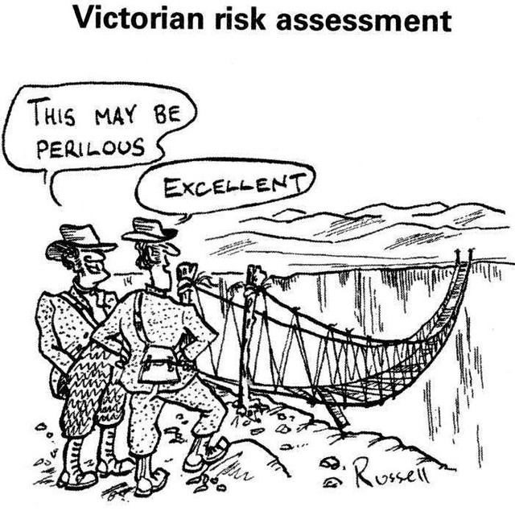
Risk Assessments – What do we expect to see?

Slide 6
Why write a risk assessment?
Helps you plan
Insurance need the info
Consider relevant risks
Prepared for if things go wrong
Supervisor can assess & support
Notes:
So why write a risk assessment? As it says Helps you plan – it’s a detailed planning document about what you are going to do and how you can do it safely.
GO THROUGH THE SLIDE…..
People who have already thought about what things can go wrong and what safeguards they may need to put in place are better about to deal with things if they happen – what if your purse/wallet gets stolen or lost.

Slide 7
Why write a Risk Assessment?
Health & Safety at Work Act / regulations
safe ‘systems of work’ for staff & students
Common Law ‘Duty of Care’
take reasonable steps to provide for safety of staff & students
Contractual duty to staff to act safely
Contractual relationship between the University & individual students
BUT…
HSWA applies to the UK
Civil Law can apply to overseas work
the University policy is that……
.….a similar standard of care must be applied overseas as would be required in the UK…..
Notes:
An employee:
Is bound to provide ‘loyal, diligent and faithful’ service to the employer according to the terms of the employment contract and owes a ‘duty to act’ with the utmost good faith in the advancement of the employer’s interests
A student:
Must adhere to the codes of conduct set out in relevant University regulations as they relate to students
Both therefore have a duty of loyalty to the University

Slide 8
University Policy
Overseas Travel (University policy statement - S3/07)
Safety in Fieldwork (University policy statement – S5/07)
https://safety.admin.ox.ac.uk/travel-and-fieldwork
This Photo by Unknown Author is licensed under CC BY
Notes:
2 main policies applicable to you. For Year Abroad students the overseas travel policy is the key on but the fieldwork policy can also be useful depending on what you are doing.
They can be found via the university website.

Slide 9
University Policy
Overseas Travel (S3/07) requires those staff / students who travel or work overseas on University business to:
Complete a suitable & sufficient risk assessment
“…nature and complexity of the assessment should reflect the risks involved in the work…”
Submit a risk assessment to the Safety Office whenever the work is done within an area that the Foreign, Commonwealth & Commonwealth Development advise against travel.
https://www.gov.uk/foreign-travel-advice

Slide 10
How far do you have to go?
The more remote, volatile, lacking in support and high risk your travel (or fieldwork) then…….
Planning
Risk Assessment
Preparation
Training
Emergency planning
Communications
EFFORT
….as far as reasonably practical….

Slide 11
FCDO travel advice
Sometimes advises against travel
- all travel
- all but essential travel
- all areas or parts of a country
Detailed risk assessment needed
Justification for travel
Robust coms and emergency plans
Reviewed by Safety Office
Approved by Head of Department
What then?

Slide 12
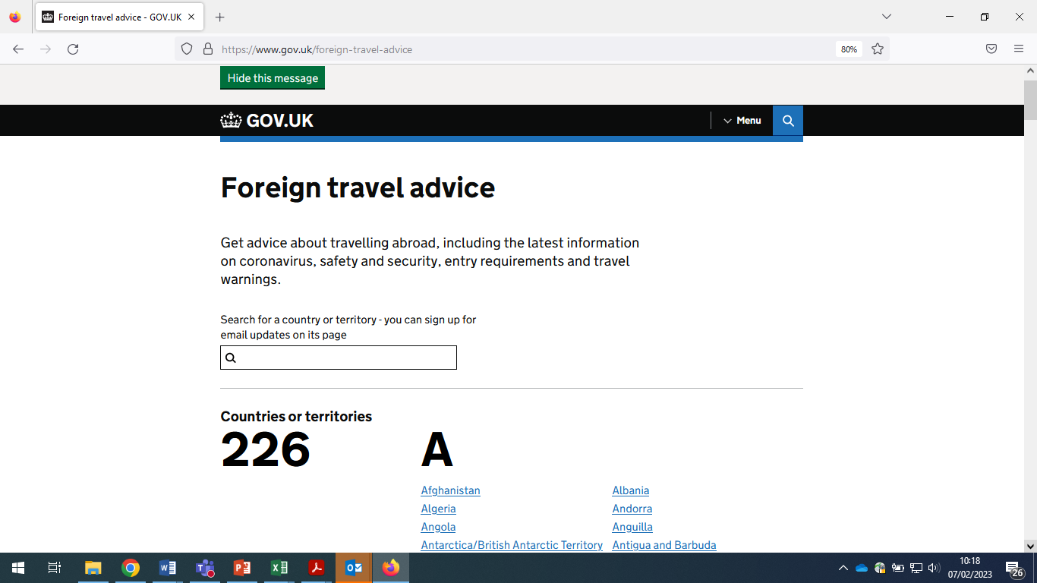
Notes:
Doing a search is really easy.

Slide 13
Foreign, Commonwealth & Development Office

Slide 14
Risk Assessment Template

Slide 15
Assess Risk Level

Slide 16
Medium and High Risk

Slide 17
High Risk

Slide 18
What do we look for?
Who is involved?
What are you doing?
Where are you going?
What local support?
Experience/Local knowledge?
Security – Current?
Security – Future?
Contingencies?
Accommodation
Activities
Communications
Events
Food / Drink
Health
Money
Travel

Slide 19
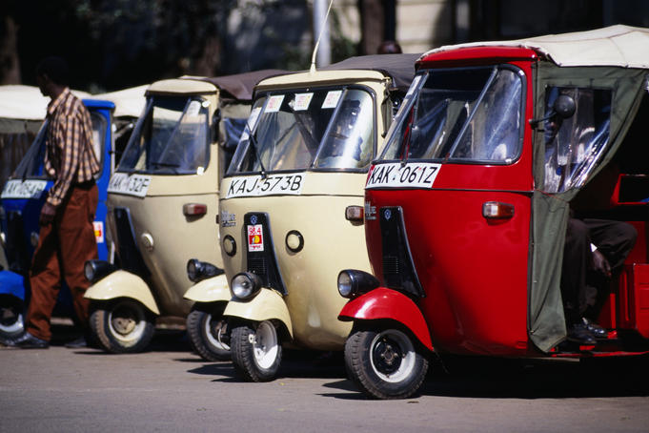
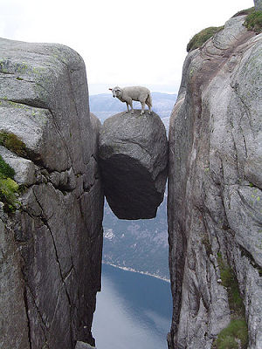
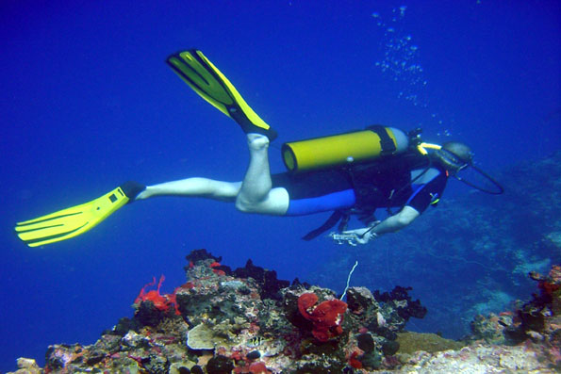
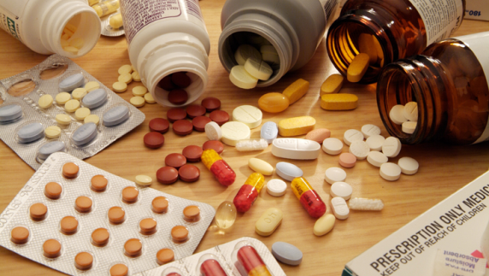
UNIVERSAL RISKS
how will you get there and get around?
where are you going to stay?
GENERIC RISKS
any risky activities?
what’s ‘dangerous’?
SPECIFIC RISKS
any local dangers?
any health – related issues?
ANY COUNTRY / AREA SECURITY RISKS?

Slide 20
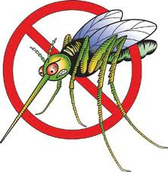
Travel Health
Important to get advice from College doctors:
fitness to travel / work abroad
immunisations you might need
Malaria (and other) prophylaxis
infection risks
general travel health and hygiene issues
Consult in plenty of time before travelling
ALSO: Fit for travel for travel health info’:
https://www.fitfortravel.nhs.uk/home.aspx

Slide 21
Crime and Civil unrest
‘The Arab Spring’ of 2010 – new cases of civil unrest or is this now the new ‘normal’…?
INTRINSIC?
GENERALISED CRIME – be prepared and always vigilant
IRREGULAR CRIME – know the good and bad areas
PERIPHERAL CRIME – don’t be complacent and become vulnerable
The Euro area – Iceland to Athens then Paris, Brussels, Nice, Stockholm, London?
DYNAMIC?
Notes:
GENERALISED – preparation required, must remain hyper-vigilant in these environments
IRREGULAR – characterised by good and bad areas, need to become familiar with no-go areas
PERIPHERAL - Area feels safe so many people become vulnerable to crime

Slide 22
Personal Characteristics
Notes:
What makes you – you! An individual's personality and characteristics - including their experiences, attitudes, behaviour, gender identification, and health - have an impact on how they approach risk. Certain characteristics may make someone more vulnerable in certain settings. Characteristics are not inherently good or bad, but being aware of how they may protect us or make us vulnerable, can help us to stay safe.

Slide 23
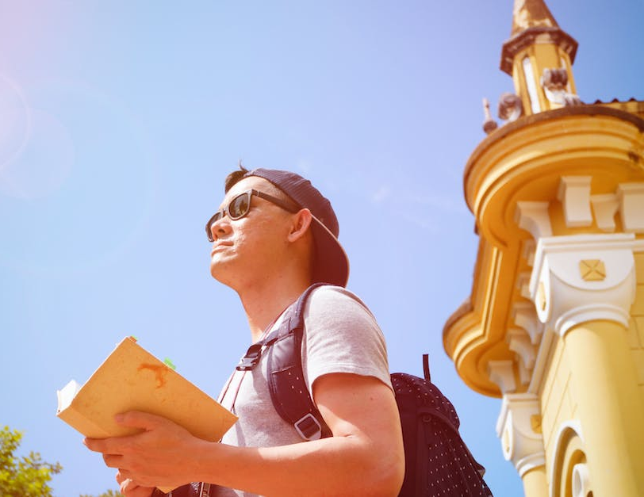
Strengths / vulnerabilities
Experience & personality
Behaviour & actions
Gender, ethnicity, religion, language
Local culture – less liberal countries
Health conditions
Digital footprint
Notes:
Be careful about your digital footprint

Slide 24
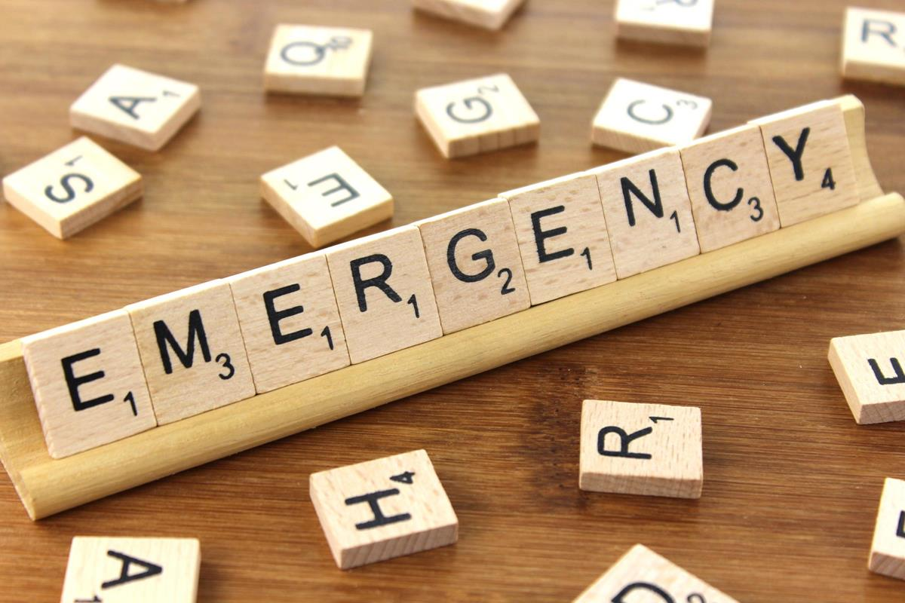
Plan … for Emergencies
TRAVELLERS should have:
A basic security and safety plan
communications plan – routine ‘checking in’ and in case of emergencies
Know your Departmental / Faculty / College emergency contact(s
DEPARTMENTS / FACULTIES should:
know when staff / students travel for business / study
retain contact & next of kin details
ensure anyone named as an emergency contact knows what to do and how to assist, if necessary
This Photo by Unknown Author is licensed under CC BY-SA
Notes:
Obviously we hope you never have to use your emergency plans, but they are there to support you if something does happen. Some things may be beyond your control or you are in the wrong place at the wrong time, but the better plans you have in place the better able you are to deal with the situation – robbery, illness, natural disaster etc.
GO THROUGH SLIDE.
Checking in – what happens if you don’t check in? What happens next?
Communication plan in disasters – terrorist attacks in Belgium – mobile services were taken down for some time. Make sure you have alternatives in place – internet, whatsapp, facebook etc. If your department cannot get through to you/haven’t heard from you they may contact your emergency contacts – make sure they know that might happen and keep the details up to date.

Slide 25
Do things happen?
Giulio Regeni’s last messages before his death in Egypt counter spy claims Facebook messages from the Italian student killed in Cairo in 2016 show concerns about studying in the country
Students withdrawn
from Russian and Ukraine
due to conflict
Student detained due to ‘suspicious behaviour’
Plane spotters arrested on terror offences
for ‘taking pictures in a Nairobi airport bar’
Students spiked in bars
British geologist jailed in Iraq for taking stones from historical site
Notes:
The vast majority of trips and Year Abroad experiences are good. However, things do happen and Chris, the team, tutors do their best to support students, but it is you on the ground if something happens. Just a few of examples of things that happen, and they can happen very quickly. In terms of Russia/Ukraine, students had to leave urgently and routes out were getting more difficult.

Slide 26
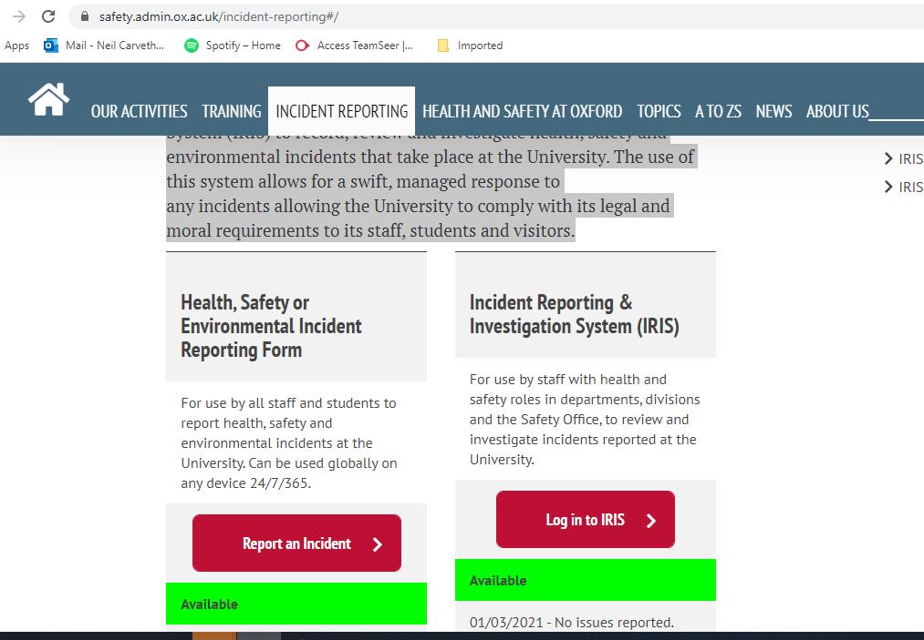
Accident Reporting Whilst Away
The University uses an online Incident Reporting and Investigation System (IRIS) to record, review and investigate health, safety and environmental incidents that take place at the University. The use of this system allows for a swift, managed response to any incidents allowing the University to comply with its legal and moral requirements to its staff, students and visitors.
https://safety.admin.ox.ac.uk/incident-reporting

Slide 27
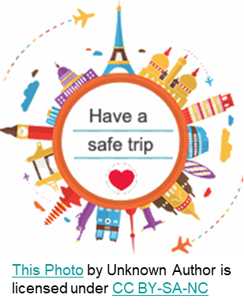
Finally….
Be cautious/vigilant
Assess situations and activities dynamically with common sense
Be flexible & have contingency plans
Keep in touch with your supervisor & update on changes
If unsure, ask.
Above all…….enjoy the experience!
Notes:
The good thing about risk assessment is that you are doing them all the time.
Sessions like this are not to scare you - help prepare you to look after yourself. Using the experience of the previous YA students, the expertise within your department and local knowledge will put you in the best place to do this.
Most people travel abroad without any problems but as we have seen in recent times things can change quickly.
Your Year Abroad - amazing time to immerse yourself in a country or countries and gain new language skills and new experiences. So above all enjoy!
END SHOW – stop sharing – happy to answer questions now or you have my contact details so please do not hesitate to get in touch. Thank you.

